Slide 1
SPOT PROJECTION WELDING MAHCINE

Slide 2
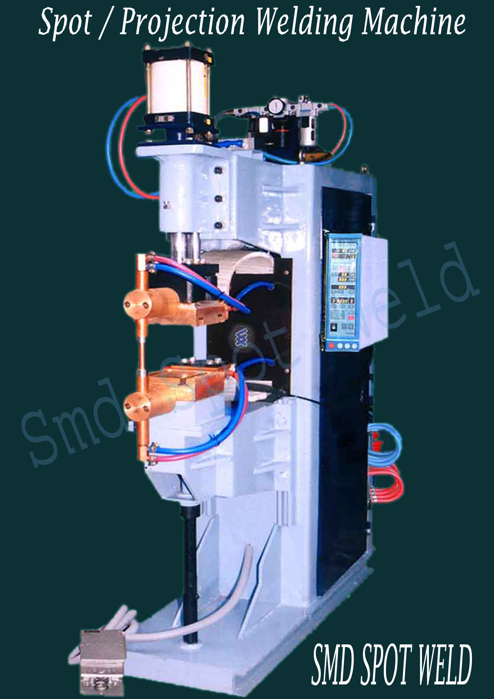

Slide 3
Spot / Projection Welding Machine
Model | Rated capacity at 50% | Phase & input voltage | Frequency | Duty cycle at max current | Max short circuit current spot/projection @200 TD | Throat depth for spot | Top holder diameter
 |  |  |  |  |  |  | Diameter | Length
unit | KVA | Volt | HZ | % | A | MM | MM | MM
SP-50 | 50 | 220/440V (2 phase) | 50/60 | 6.5 | 16,000 | 300 | 25 | 150
SP-75 | 75 | 220/440V (2 phase) | 50/60 | 5.8 | 18,000 | 300 | 25 | 150
SP-100 | 100 | 220/440V (2 phase) | 50/60 | 6.8 | 24,000 | 300 | 30 | 150
SP-150 | 150 | 220/440V (2 phase) | 50/60 | 3.4 | 28,000 | 300 | 30 | 150
SP-200 | 200 | 220/440V (2 phase) | 50/60 | 2.8 | 34,000 | 300 | 40 | 150

